Slide 1

Maze Solving Project
-Anissa Sollman, Mani Botla, Nick Liverett

Slide 2
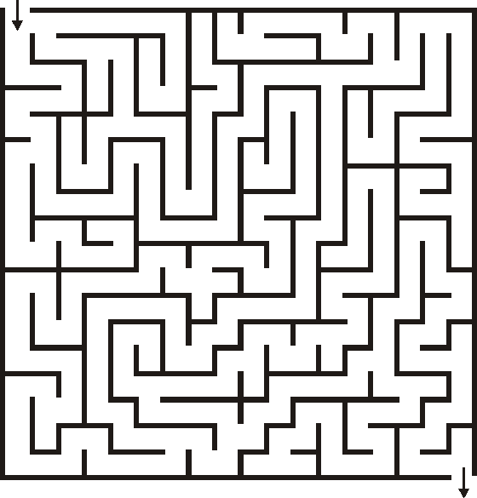
Overview
Finding a path from a starting position to a destination within a maze.
Represented using a 2D array or matrix.
Helps develop key search algorithms (DFS, BFS, A*)
Real‑world use: routing, navigation, logistics, GPS systems

Slide 3
Research Hypothesis
Goal : Compare maze‑solving algorithms to find the most efficient shortest‑path method.
Four algorithms were used:
- Breadth First Search (BFS)
- Depth First Search (DFS)
- A* Search
- Ant colony optimization(ACO)
Expectations:
Expected A* to be fastest and efficient.
Expected DFS to take longer and be less optimal.

Slide 4
Experimentation
DFS, BFS, and A* tested on all maze types; ACO worked only on small mazes
ACO influenced by pheromone strength and several other factors.
ACO much slower due to many ants and iterations.
Adjusted factors made ACO too deterministic on small mazes i.e showed very fast convergence.

Slide 5
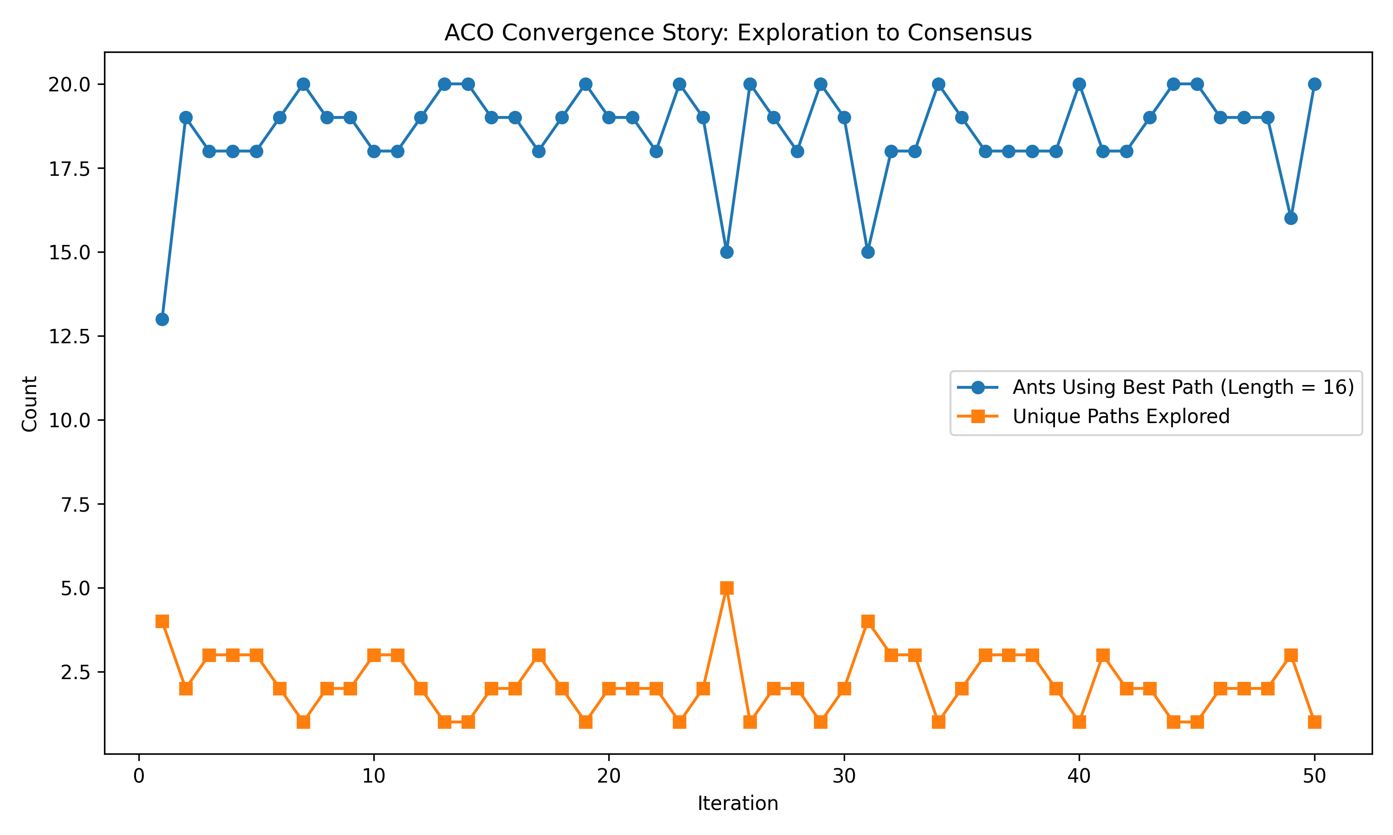
results
Ants quickly begin choosing the best path (length 16).
Unique paths explored drop to very low numbers
Shows strong convergence
Stable behavior
Best- path usage stays high across iterations

Slide 6
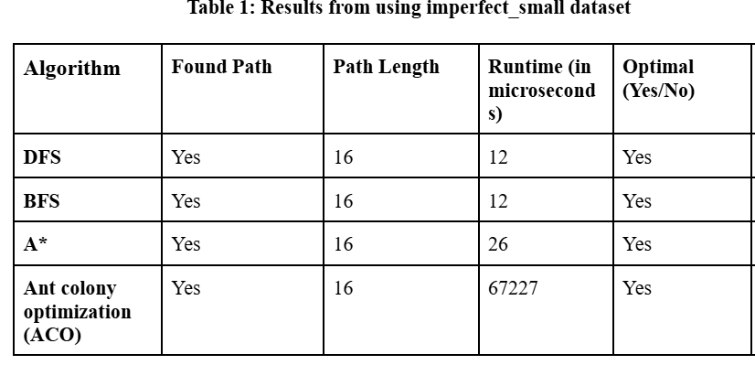
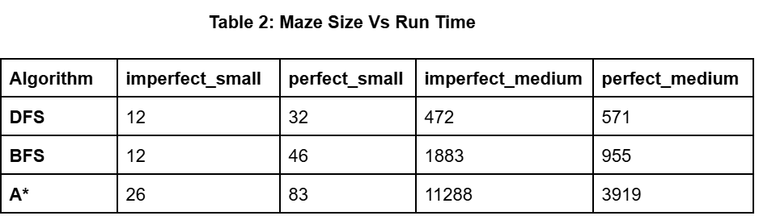

Slide 7
Analysis
The results show that no single algorithm works best for every maze size.
For instance, in imperfect_small dataset, BFS and DFS are the most practical choices.
DFS performed best for runtime efficiency.
BFS performed best for guaranteed shortest path finding.
A* is useful when a strong heuristic exists.
ACO was best for optimization analysis.

Slide 8
Analysis
In ACO convergence story, only 13 ants used the best path in the first iteration.
This shows that colony initially explored multiple possible routes instead of immediately agreeing on one solution.
By second iteration, the number quickly increase to 19 ants, showing rapid pheromone reinforcement toward the shortest path.
Across most of the 50 iterations, between 18 and 20 ants consistently used best path, indicating strong convergence and stable consensus.
Key Takeaway: ACO can reliably converge to the optimal maze solution.

Slide 9
Future directions
Make ACO work for other graph sizes
Test more with different iterations and size of ant colonies
Alter pheromone factors
alpha: how strongly ants follow pheromone ~ 1.0
beta: controls how strongly ants prefer moves that appear closer to the goal ~ 2.0
evaporation: how strongly pheromone trails stay ~ 0.4
Q: controls how much pheromone successful ants drop ~ 50.0
exploreRate: controls how much ants will randomly explore ~ 0.05
maxSteps: prevents indefinite wandering ~ 4*(width+height)
e

Slide 10
Road blocks
We wanted to use multiple graph sizes to compare the algorithms, but the ACO algorithm uses pheromone factors which influence ant movement affecting output for medium size graphs.
If we wanted ACO to work for small graphs, ants were not able to explore a larger size graph efficiently.
If we did the opposite, ACO would be too deterministic for small graphs.
Ultimately, even if our ACO worked for larger graphs, we would need a significant amount of data to show convergence.
Since it takes an ant colony several iterations of the algorithm to build a stronger pheromone trail, we have to record several outcomes from each iteration, such as successful ant count, number of unique paths, and number of ants taking each unique path.

Slide 11
references
Introduction to Ant Colony Optimization - GeeksforGeeks
Ant Colony Optimization - Intuition, Code & Visualization | Towards Data Science
Depth First Search or DFS for a Graph - GeeksforGeeks
Breadth First Search or BFS for a Graph - GeeksforGeeks
A* Search Algorithm - GeeksforGeeks
The A* Algorithm: A Complete Guide | DataCamp

